Slide 3
The POWER of Parameters

Slide 4
I have placed the sand as a boundary for the sea, an eternal decree, so it cannot cross over it… Jeremiah 5:22a

Slide 6
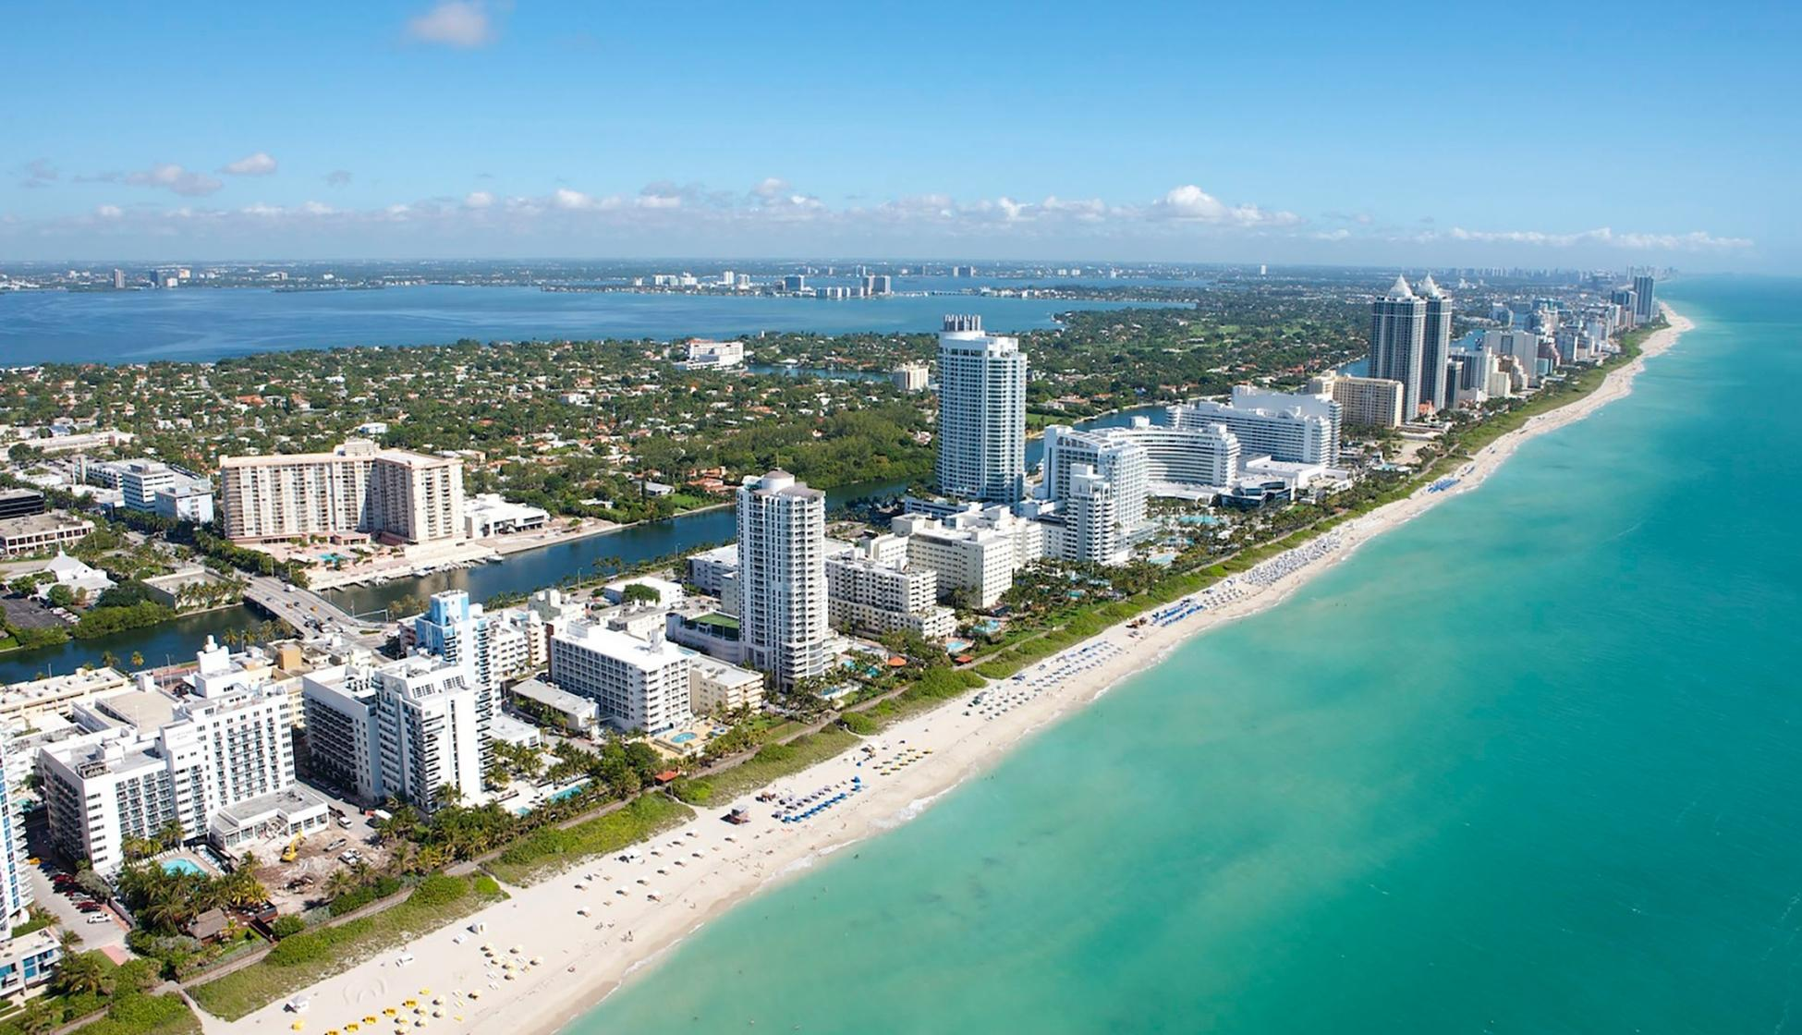
Confidence to
Invest & Build

Slide 7
I have placed the sand as a boundary for the sea, an eternal decree, so it cannot cross over it… Jeremiah 5:22a

Slide 8
The Courage
to Grow with Confidence is in
the PARAMETERS

Slide 9
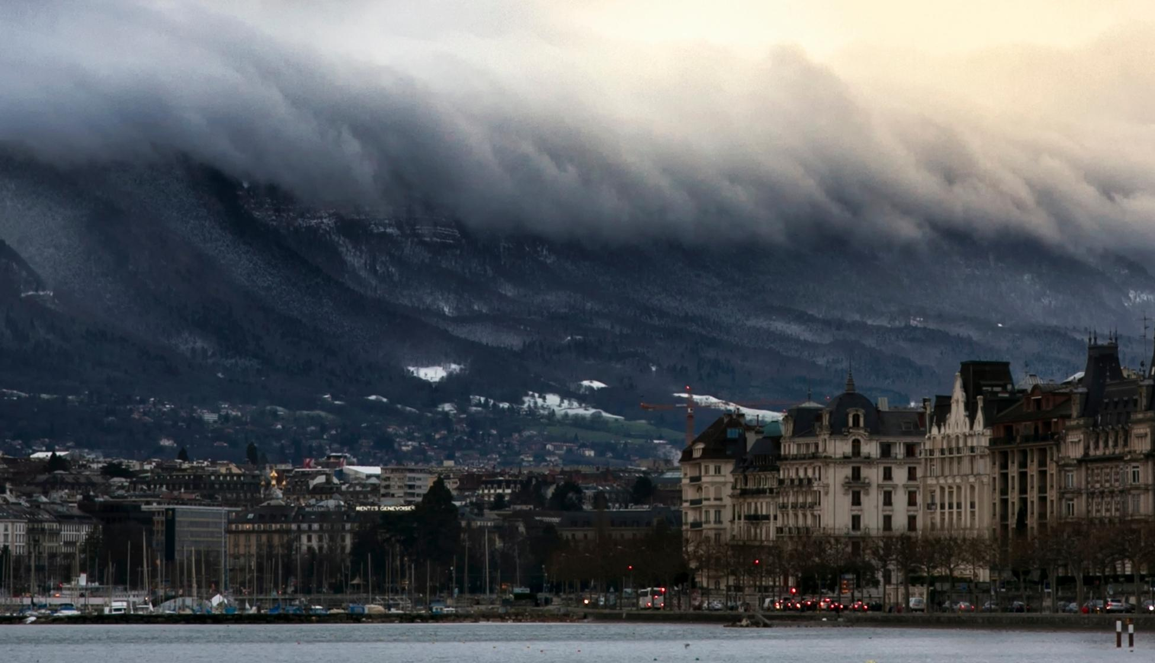

Slide 10
I have placed the sand as a boundary for the sea, an eternal decree, so it cannot cross over it. Though the waves toss, yet they cannot prevail.
Jeremiah 5:22

Slide 11
Tsunami Seasons include…

Slide 14
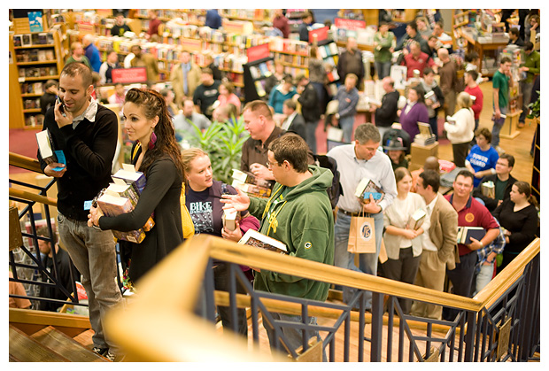

Slide 16
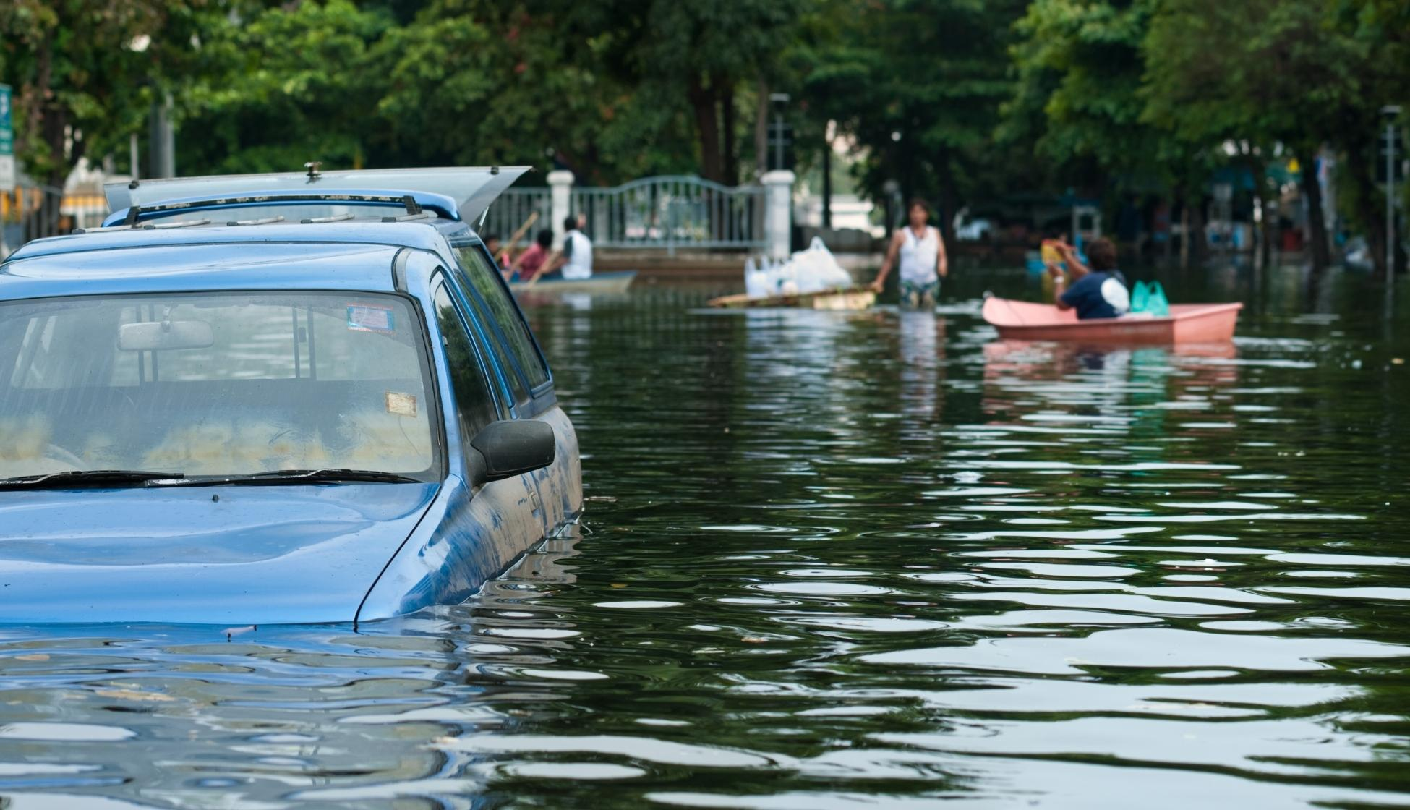

Slide 18
Tsunami & Flood CleanUp
New Baby & New Business
are supposed to be for a SEASON

Slide 26
List your current,
possible or probable
IMBALANCES
*Star “ongoing” vs. NEW anything

Slide 27
BIBLE EXAMPLES
of Parameters

Slide 28
God blessed the 7th day. You have established and hallowed it. Gen 2:3
You have made summer and winter, and set all the boundaries of the earth. Psalm 74:17
I will fix your boundary from the Red Sea to the sea of the Philistines, and from the wilderness to the River Euphrates; for I will deliver the inhabitants of the land into your hand, and you will drive them out before you. Exodus 23:31

Slide 29
Nehemiah – 100% focus was on rebuilding the wall
Jonah – 100% focus was on winning Ninevah
Daniel & Joseph – 100% focus on honoring God while building the health of the nation of Israel’s arch enemy
Deborah – 100% focus on LEADING but not GOING into battle to win that war
Paul – 100% focus on reaching the Gentiles while equipping all Christ-followers

Slide 30
Don’t let one verse, taken out of context,
destroy your life & ministry.

Slide 31
Don’t let one verse, taken out of context,
destroy your life & ministry.
Though I am free and belong to no one, I have made myself a slave to everyone, to win as many as possible. I Corinthians 9:19

Slide 32
But Jesus would not entrust himself to them, for he knew all people. John 2:24

Slide 33
I can do nothing of Myself, indepently, of My own accord, but only as I am taught by God. As I hear, I judge, and My judgement is righteous, because I do not seek My own will, but only the will of the Father. John 5:30

Slide 34
How MISSION/VISION serve as parameters.

Slide 37
PARAMETERS PREPARE YOU TO SAY
YES TO GOD
EVERY SINGLE TIME

Slide 38
Auto-defaulted to standard parameters, with exceptions:
Did not heal, teach, lead, etc until he had served as a carpenter for 30 years before starting His public ministry (ie - was found by his parents teaching the scholars in Jersulam)
Healed everyone who came by faith (but not at the Pool of Shaloam, there healing only one man, who seemed not to have faith; left the rest)
Always available to crowds and individuals (except when He often withdrew to the wilderness to pray. Luke 5:16)
Said NO when it was outside the auto-default, but would switch to YES upon release (1st miracle - Wedding of Cana & Gentile woman – vs. focus on the Jews)

Slide 39
Every time I say YES to something
I have, in effect, said NO to something else.
Every time I say NO to something
I have, in effect, said YES to something else.

Slide 40
The goal is to
say YES to God
Every Single Time

Slide 41
Field Work
From your brainstormed list, enter the *starred items into the left column of your graph as “categories.”
Clarify your parameter needs by listing specific types of requests, inquiries, calls, invitations, emergencies, pleas, ideas, time investments and so on, to the right of each category head.
Prayerfully determine a baseline, auto-default parameter statement for each.

Slide 43
Example: Speaking Parameters
Categories
Audience Types | Christian | Business | Gov/NGO | Adults | Children
Location/Distance | Virtual Only | Local + 2 hours | Drive + overnight | Fly USA | Fly Global
Remuneration | Free Love Offering | Work w/Budget | Fee Structure | Donations Sponsors | Grants Contracts
Financial Investments | Training | Assistant | Marketing | Wardrobe
Time / Hours to… | PMs / Calls Emails Social Pongs | Interviews Proposals Preparation | Meetings Trainings Interviews | PPTs Handouts | Travel

Slide 44
Clarify Each Default Boundary
Categories
Audience Types | *Christian – Mostly Women | Business | Gov/NGO | Adults -- Mostly women | Children
Location/Distance | Virtual: Up to 1x/day, 3 days/wk | Local + US Travel: Max 2/mo | Drive + overnight (see left) | Fly USA: Up to 1x/mo | Fly Global: Up to 3x/yr (= 2 USA)
Remuneration: Must include travel exp reimb | Free Love Offering | Work w/Budget | Fee Structure | Donation Sponsor | Grants Contracts
Financial Investments | Training Coaching $500/mo | Assistant: $200/wk | Marketing: Mostly WOM $100/mo | Wardrobe: NA
Time / Hours to… | PMs / Calls Emails Social Pongs | Interviews Proposals Preparation | Meetings Trainings Interviews | PPTs Handouts | Travel

Slide 45
Identify Hot Spots
Categories
Audience Types | *Christian | Business | Gov/NGO | Adults: Mostly women | Children
Location/Distance | Virtual: Up to 1x/day, 3 days/wk | Local + US Travel: Max 2/mo | Drive + overnight (see left) | Fly USA: Up to 1x/mo | Fly Global: Up to 3x/yr (= 2 USA)
Remuneration: Must include travel exp reimb | Free Love Offering | Work w/Budget | Fee Structure $ Amts | Donation Sponsor | Grants Contracts
Financial Investments | Training Coaching $500/mo | Assistant: $200/wk | Marketing: Mostly WOM $100/mo | Wardrobe: NA
Time / Hours to… | PMs / Calls Emails Social Pongs | Interviews Proposals Preparation | Meetings Trainings Interviews | PPTs Handouts | Travel

Slide 47
Confidence to
Invest It All!

Slide 48
Identify Hot Spots
Categories
Audience Types | *Christian | Business | Gov/NGO | Adults: Mostly women | Children
Location/Distance | Virtual: Up to 1x/day, 3 days/wk | Local + US Travel: Max 2/mo | Drive + overnight (see left) | Fly USA: Up to 1x/mo | Fly Global: Up to 3x/yr (= 2 USA)
Remuneration: Must include travel exp reimb | Free Love Offering | Work w/Budget | Fee Structure $ Amts | Donation Sponsor | Grants Contracts
Financial Investments | Training Coaching $500/mo | Assistant: $200/wk | Marketing: Mostly WOM $100/mo | Wardrobe: NA
Time / Hours to… | PMs / Calls Emails Social Pongs | Interviews Proposals Preparation | Meetings Trainings Interviews | PPTs Handouts | Travel

Slide 49
Example of Niching WAY Down
Categories
PMs / Calls
Emails / Support Forms
Social Pongs
Proposals / Prep Time
PPTs / Handouts

Slide 50
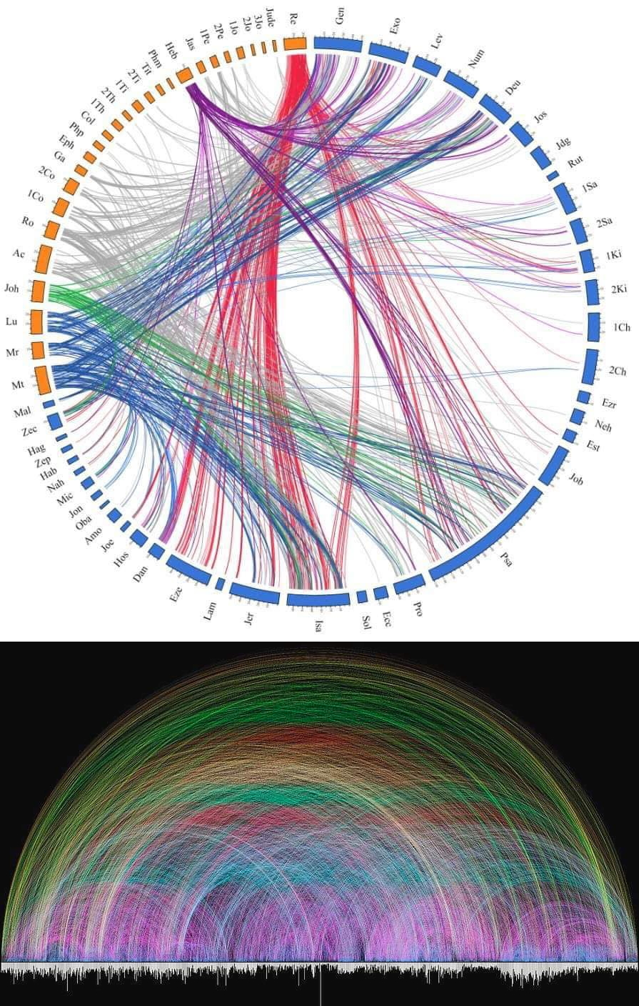
ONLY GOD
Cross reference of OT/NT promises, predictions & truthes
Copyright 2022 @ www.Marnie.com

Slide 52
Joyfully
Explore
Your
God-Given
Default Parameters

Slide 53
Run hard when it’s time

Slide 55
Example: Ministry Time Mgmt
Categories
PMs / Calls | PMs – as avail, between sessions/ meetings/projects OR every 20 min | Calls – Always to VM unless available for 20 minutes |  |  | Think like taking shifts in the ER vs. 24x7x365
Emails / Support Forms | Emails - as avail, between sessions/ meetings/projects OR every 4 hours | Email Standard: Empty in box | Support Forms: 1x AM, 1x end of day | Set the expectation of a time lapse prior to response | Think like the President or a Famous Person
Social Pongs | Post: 2x/day to 6 channels | Pong: AM & 1 other time/day | LIN: T.W.Th Extra | LIN: Friday Connection Hour | Play Ping Pong w/ mostly pongs
Proposals / Prep Time | Block 3 hours, 2x/week | If no props or prep (travel arrangements, billing, etc)… | Use time for new-resource creation | OR to promote a recent release | Schedule as if traveling or speaking @ a conference
PPTs / Handouts | This is NEW RESOURCE creation | Has to fit into the 6 hrs/wk | Usually able to reformat existing content | Heavily rely on Master: Talk Points & PPTS | Schedule as if traveling or speaking @ a conference

